Slide 1
Machine Learning for Survival Prediction of Passengers on the Titanic
CAI Shizhan,
SONG Wenxin

Slide 2
Methodology
Step 1: Data overview, processing, and exploratory analysis
Step 2: Model diagnostics
Step 3: Model selection
Step 4: Result and Discussion

Slide 3
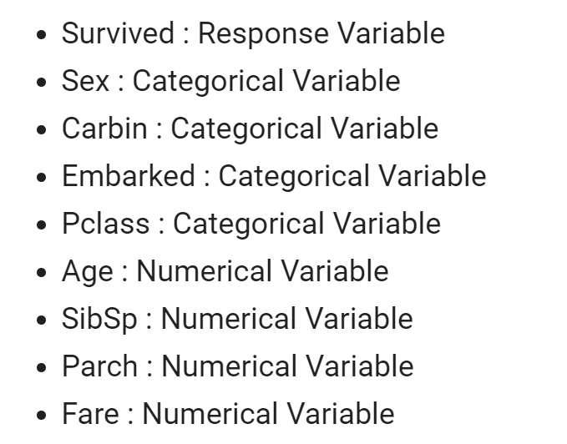
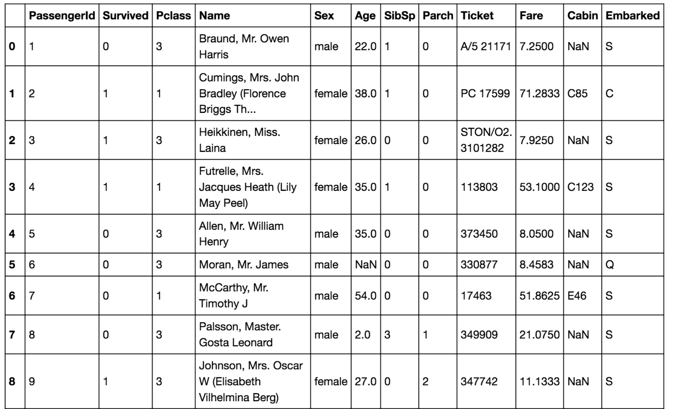
1.1 Data Overview

Slide 4
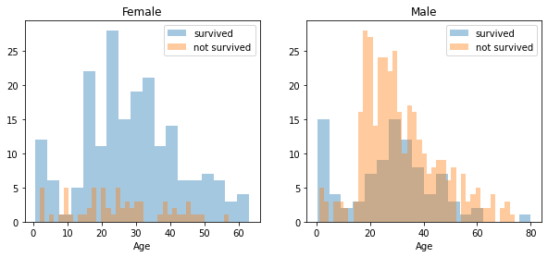
1.1 Data Overview(Sex & Age)
Female
Higher survival rate
Most of the women are 12 ~40 years old
There are some intervals like [0,10], [11,20]
Maybe we can categorize ‘Age’ feature and let variables fall into each interval.

Slide 5
1.1 Data Overview(Sex & Age)
Male
Lower survival rate
Most of the men are 10 ~50 years old
There are also some intervals
We can also try to categorize in male’s age.

Slide 6
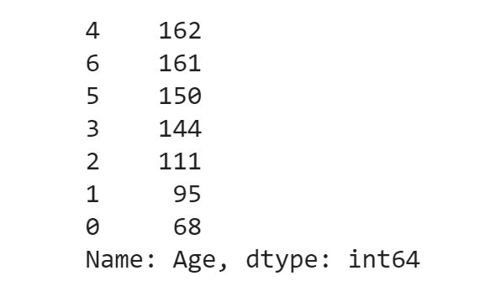
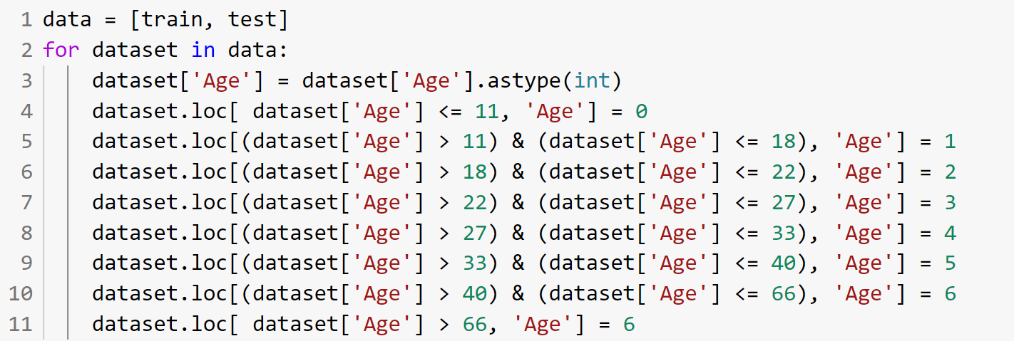
1.1 Data Overview(Sex & Age)

Slide 7
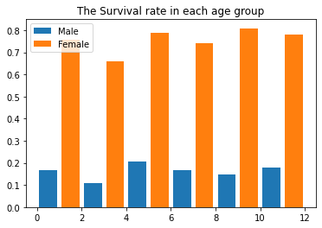
1.1 Data Overview(Sex & Age)
In each group, the survival rates are alomst equal.
Initial finding: Sex is a really important feature.
However, this step didn’t improve the result. We use the original data to keep the readability.

Slide 8
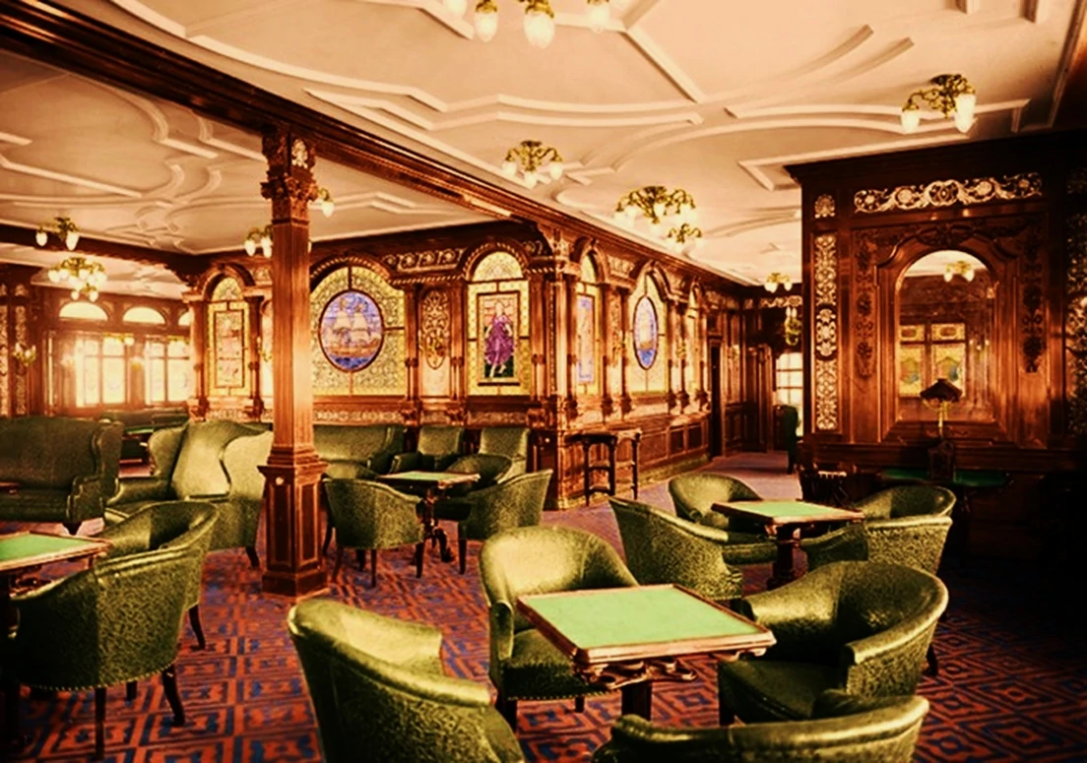
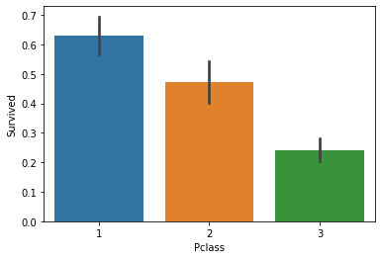

1.1 Data Overview(P Class)
First Class photo from wiki
Third Class photo from wiki

Slide 9
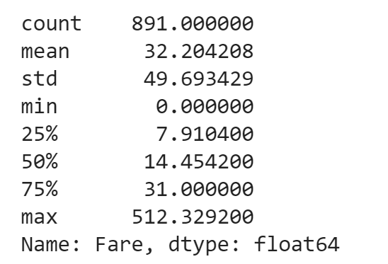
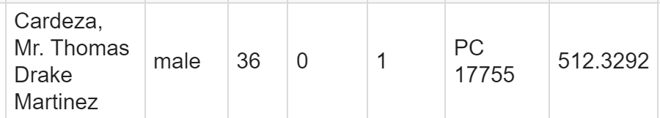
1.1 Data Overview(Fare)
We found that mean is just 32. However, some people’s fare were extremely high. Intersting fact is shown below.
maid
manservant
banker

Slide 10
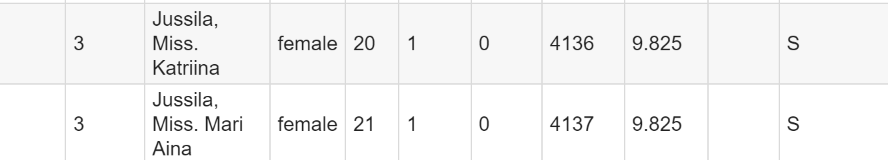
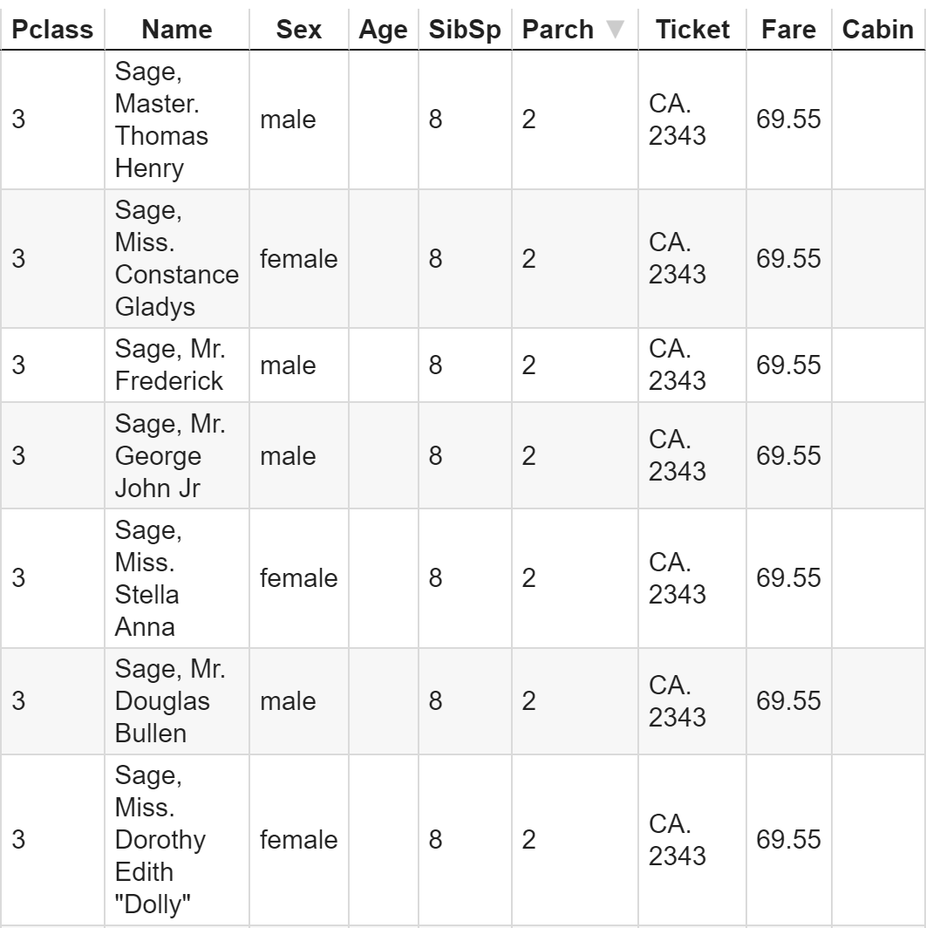
1.1 Data Overview(Fare)
Two sisters from the family share same amount of fare.
Several people from Sages family. 69.95/7 = 9.992!

Slide 11
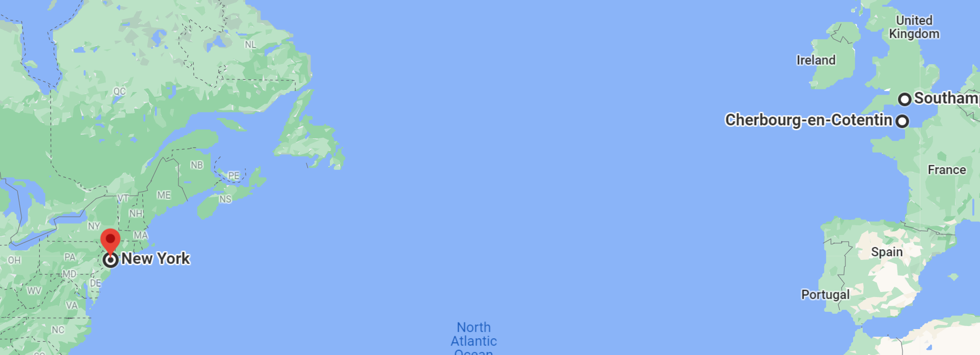
1.1 Data Overview(Embark)

Slide 12
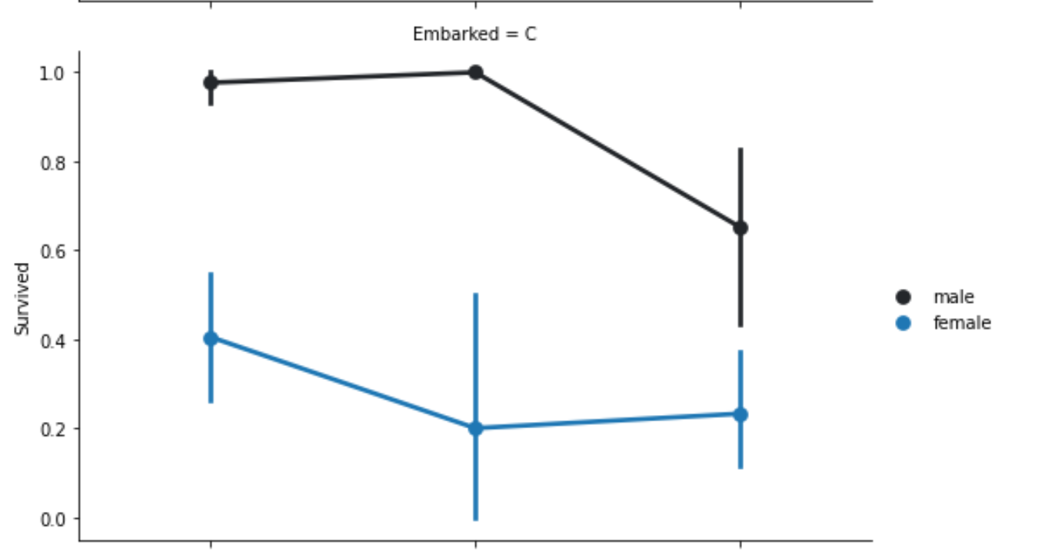
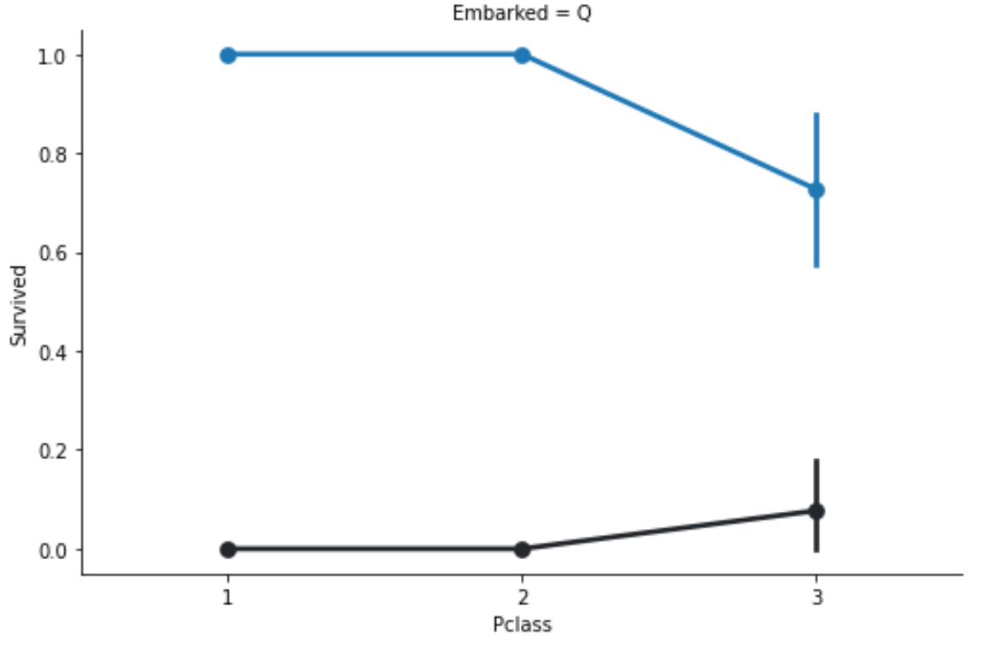
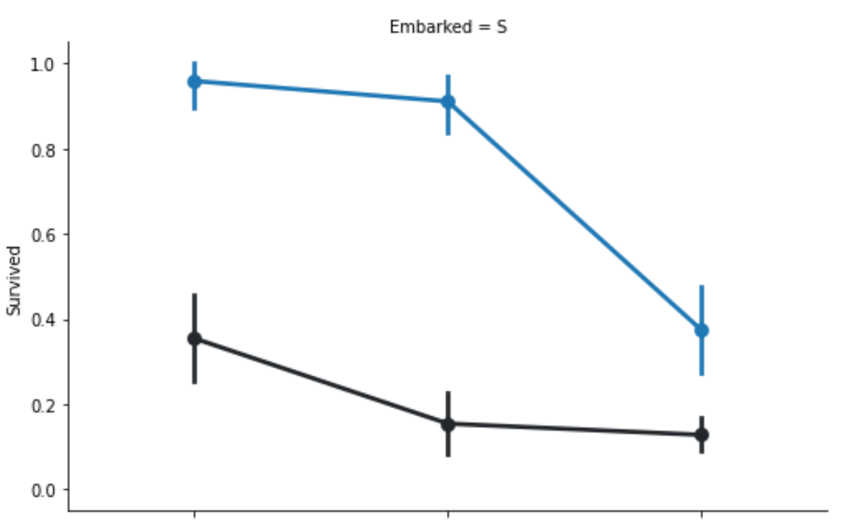
1.1 Data Overview(Embark)

Slide 13
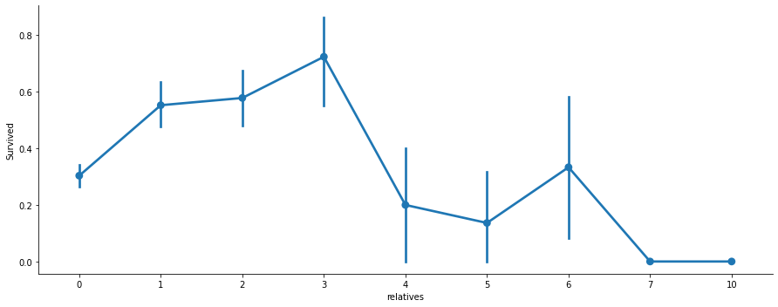
1.1 Data Overview(Family: SibSp & Parch)
SibSp: Siblings/Spouse;
Parch: Parents/Children

Slide 14
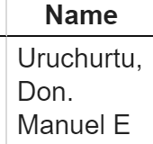
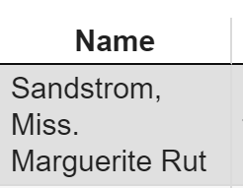
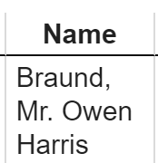
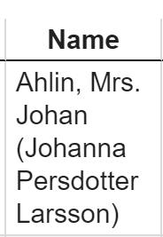
1.1 Data Overview(Name)
Mr
Mrs
Miss
Master
Rare:
'Lady', 'Countess','Capt', 'Col','Don', 'Dr', 'Major', 'Rev', 'Sir', 'Jonkheer', 'Dona'

Slide 15
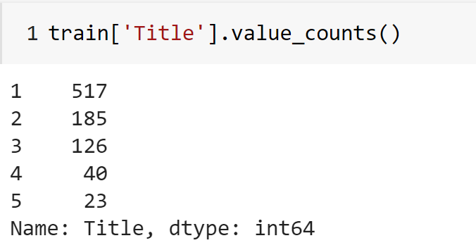
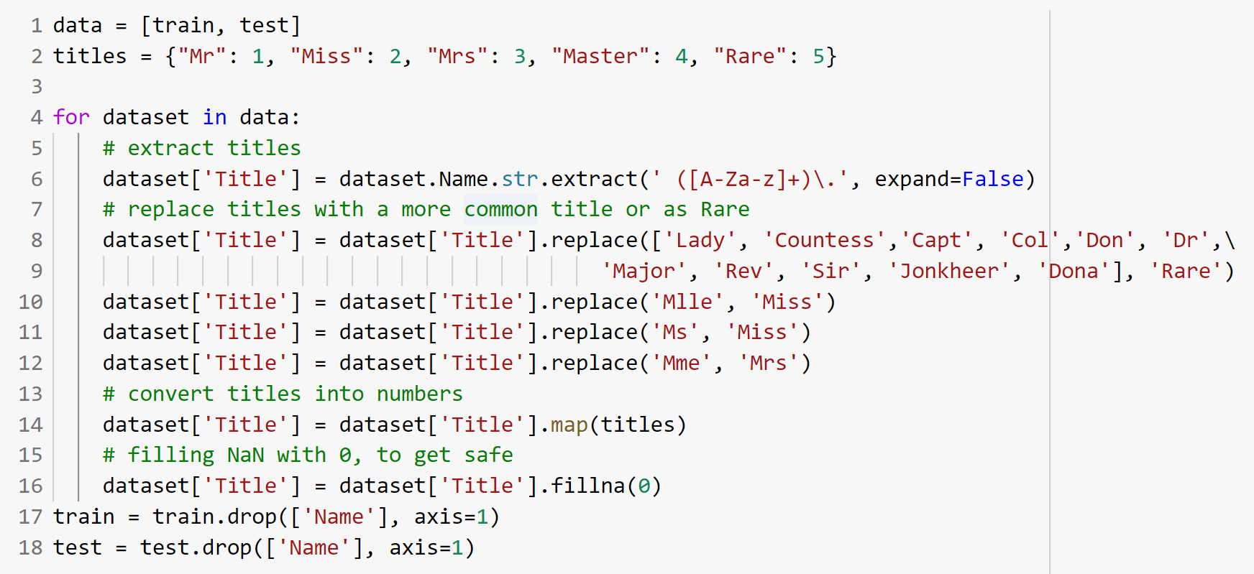
1.1 Data Overview(Name)

Slide 16
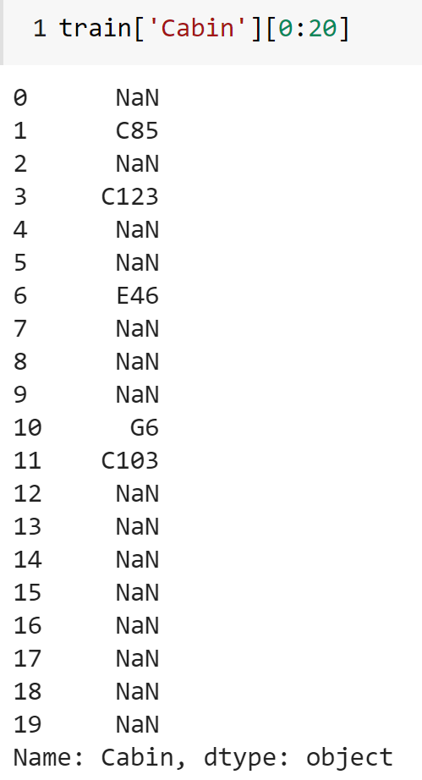
1.1 Data Overview(Cabin)
As we can see, there are many missing data in ‘Cabin’ feature.(77.1%).
Basically, ‘Cabin’ contains the information like ‘floor’ and the distance to lifeboat. However, if we didn’t deal with these properly, then the model may overfit.
It’s tricky to fill these ‘NaN’.
We decided to drop this feature.

Slide 17
1.1 Data Overview

Slide 18
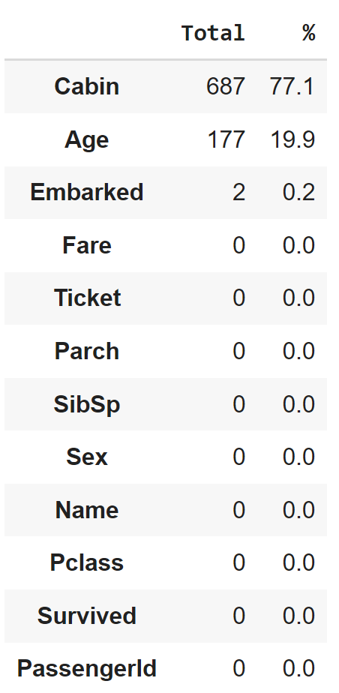
1.2 Data Cleaning and Processing
Drop
PassengerId, Ticket, Carbin, Name
Deal with missing values.
Age, Embarked, Fare
Transform
Fam_count, isAlone, F_pp

Slide 19
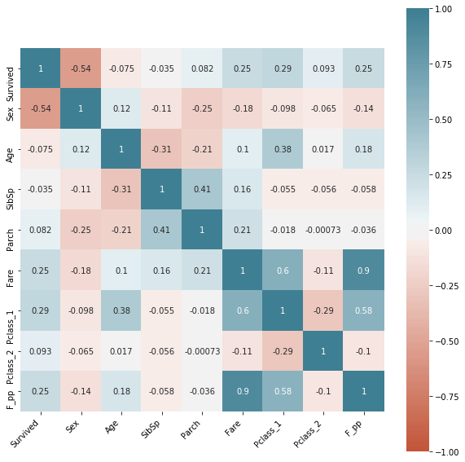
2. Model diagnosis
After processing, we decide to use the following processed variables:
Sex, Age, SibSp, Parch, Fare, Family, isAlone, Pclass_1, Pclass_2, Embarked_S, Embarked_C
-> Multicollinearity check
criterion: vif < 10

Slide 20
3. Model selection
Five kinds of models
Logistic regression with forward selection/ backward selection
KNN
SVM
Decision Tree
Random Forest
Modelling method
Apply 5-fold cross validation for feature selection on each model. Repeat this for multiple times and calculate the average to ensure randomness.
Choose the model with the highest accuracy and tune hyper parameters

Slide 21
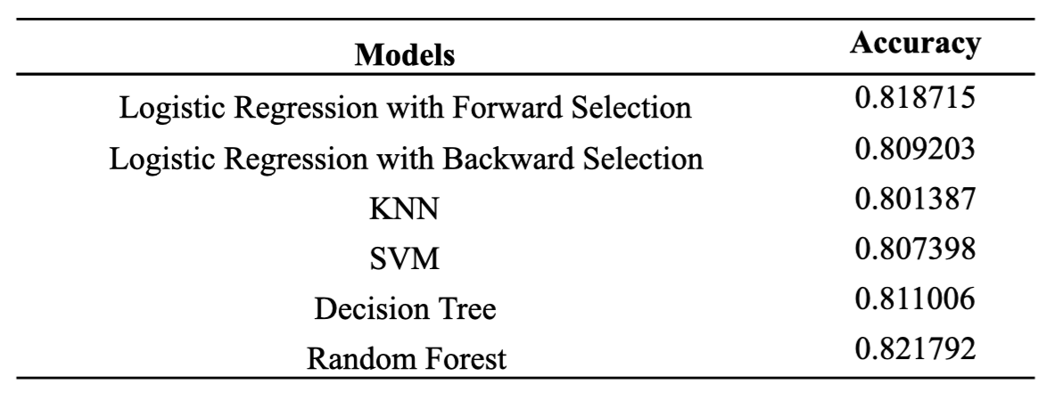
3.1 Model Comaprision

Slide 22
3.2 Hyper parameter tunning
GridSearch:
criteria: gini, entrophy
max_feature
min_sample_splits
min_sample_leafs

Slide 23
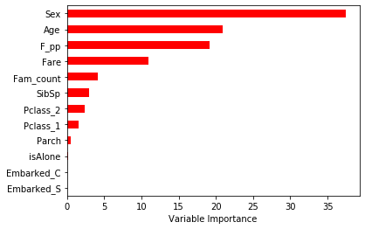
3.3 Final Performance

Slide 24
4. Conclusion & Discussion
84%
82%
On Validation Set
On Testing Set

Slide 25
4. Conclusion and Discussion
Best model: Random Forest
removing the outliers and influential points
interaction terms

